Slide 1

Customer Insights Dashboard
by Afrah Alanazi
1 September, 2025

Slide 2
Introduction
"To analyze customer data in order to gain insights into purchasing behavior, salary distribution, and age group trends, with a focus on gender and age demographics, and to present the findings in a clear and visual dashboard."

Slide 3
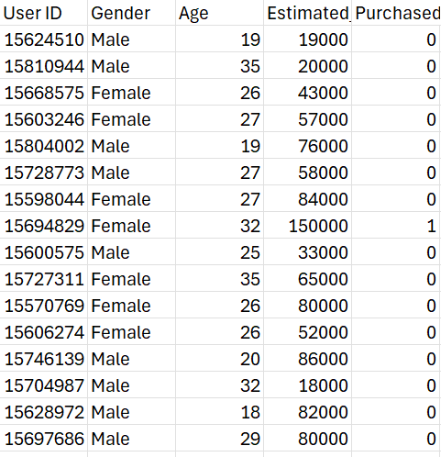
Dataset Overview
The Customer_Behavior file represents a data set which contains 400 observation and 5 characteristics of customers such as: Id, gender, Age, Salary and weather they purchased or not the company's new product.
Data source

Slide 4

Analysis
Analysis Overview:
Analyzed customer data by age, gender, and salary
Calculated total salaries for males, females, and overall
Compared purchases by gender
Examined distribution of customers across age groups
Highlighted age group with highest earning potential
Created visual charts to summarize insight

Slide 5
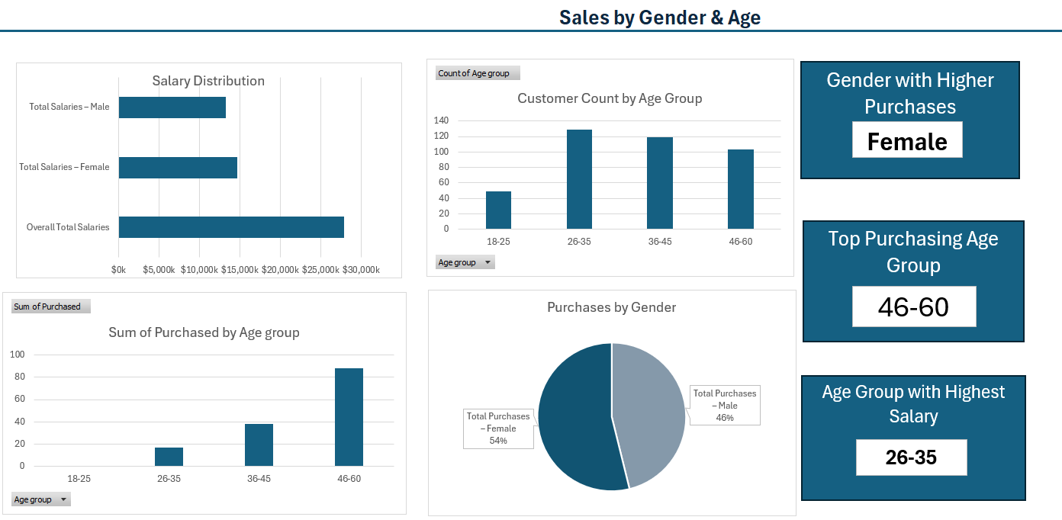
Visualizations / Dashboards

Slide 6


Results:
Total salaries compared by gender
Purchases: Females purchased slightly more than males
Highest salary by age group: 26-35
Age distribution: Most customers are in the 26-35 age group

Slide 7
Conclusion
Insights into customer purchasing behavior
Gender & age influence purchases and salaries
Helps improve marketing strategies and decision-making

